Slide 1

K S INSTITUTE OF TECHNOLOGY
DEPARTMENT OF ARTIFICIAL INTELLIGENCE & MACHINE LEARNING
PROJECT PHASE -2 REVIEW 1- BAI786
PRESENTATION ON
AI-BASED AUTOMATED E-WASTE CLASSIFICATION AND SORTING SYSTEM
1. CHIRAG GOWDA A S
2. LIKHITHA M (1KS23AI025)
3. PRATIKSHA (1KS23AI064)
4. MOHAN YADAV G S (1KS24AI402)
Assistant Professor - DEEPA.R
Department of AIML
K.S.I.T
(1KS23AI009)

Slide 2

CONTENT
Problem Statement & Objectives
Literature Survey & Existing System
Proposed Methodology
System Design
System Architecture
Progress Achieved
Expected Results
Work Plan
Expected Outcomes
9

Slide 3
CONTENT
Problem Statement & Objectives
E-waste such as batteries, PCBs, wires, and plastic parts is increasing rapidly. Manual sorting of these materials is slow, difficult, and prone to errors. Improper sorting can also cause environmental pollution and make recycling difficult.
Therefore, this project aims to develop an AI-based automated system that can identify different types of E-waste using a camera and automatically sort them into the correct bins using a conveyor and servo mechanism.
Objectives
AI-Based Classification Use a camera and ML model to identify different types of E-waste.
Automatic Sorting Use a conveyor, sensors, and servo motor to move each item into the correct bin.
Simple Monitoring Record the number and type of E-waste items sorted by the system.

Slide 4
CONTENT
Literature Survey & Existing System
S.No | Title of the Paper | Author | Name of the Journal and Publication Year of the Paper | Methodology | Drawback
1 | E-ViTNet: A lightweight vision transformer with oppositional cat swarm optimization for automated E-Waste sorting | Godfrey Perfectson Oise | 2026 | Uses a Vision Transformer (ViT) to identify different types of E-waste from images. It improves accuracy using optimization and self-learning techniques. | The model is still large and needs high computing power. It may be difficult to run on small low-cost devices.
2 | EW YOLO: Edge Computing IoT and YOLOv11 Setup for E-Waste | Shubhyansh Rai, Rashmi Chawla, Munish Vashishath, Giancarlo Fortino | 2026 | Uses YOLOv11 with IoT and edge computing to detect E-waste in real time. The detected waste can be identified for automatic segregation. | Accuracy can reduce when objects are hidden or lighting changes. It also needs suitable hardware for smooth operation.
3

Slide 5
CONTENT
S.No | Title of the Paper | Author | Name of the Journal and Publication Year of the Paper | Methodology | Drawback
3 | YOLO11 for High Accuracy Real-Time Detection and Classification of Diverse E-Waste Categories | Priyankar Biswas, Utshob Sutradhar, Md. Roni Khan, Sourav Sana, Saiful Islam, Subrata Paul | 2025 | Uses YOLO11 to detect and classify different E-waste items from images. It is designed for fast and accurate real-time detection. | It mainly focuses on detection and classification. Physical sorting using a conveyor is not fully implemented.
4 | Advancing E-Waste Classification with Customizable YOLO Based Deep Learning Models | P. Akhil Rajeev, Vivek Dharewa, D. Lakshmi, G. Vishnuvarthanan, Jayant Giri, T. Sathish et al. | 2025 | Compares YOLOv5, YOLOv7 and YOLOv8 for identifying different E-waste categories. The models are tested for accuracy and detection speed. | The dataset is relatively small. The model may have difficulty when the object appears in different directions.
5 | Real time electronic-waste classification algorithms using the computer vision based on Convolutional Neural Network (CNN): Enhanced environmental incentives | Prashant K. Sarswat, Rahulkumar Sunil Singh, Subbu Venkata Satyasri Harsha Pathapati | 2024 | Uses CNN-based computer vision and YOLO models to identify different E-waste materials. It can classify E-waste using images and video input. | It mainly performs identification and classification. Automatic physical sorting is not completely developed.
4

Slide 6
CONTENT
Existing System
The existing E-waste sorting process mainly uses manual sorting or AI-based image classification. In recent systems, cameras and deep-learning models such as YOLO are used to identify waste items, while conveyors and controllers move items for sorting.
Main Existing Approaches
Manual Sorting – Workers identify and separate E-waste items manually. It is slow and may lead to human errors.
AI-Based Classification – A camera captures the E-waste image, and an AI model identifies its category. However, some systems focus mainly on detection rather than complete physical sorting.
Automated Conveyor Sorting – Advanced systems combine a camera, AI model, conveyor, and actuator/controller for automatic sorting. These systems can be more expensive and computationally demanding for a small student prototype.
10

Slide 7
CONTENT
Overall Methodology
E-waste Placement – The user places an E-waste item on the conveyor.
Object Detection – An IR sensor detects the item.
Image Capture – The camera captures the item's image.
AI Classification – The trained ML model identifies the E-waste category.
Position Tracking – The conveyor moves the item toward the sorting point.
Automatic Sorting – ESP32 controls the servo motor to move the item into the correct bin.
Data Recording – The system records the type and number of sorted items.
Proposed Methodology
The proposed system is an Edge-AI Based Automated E-Waste Classification and Sorting System. It uses a camera to identify the type of E-waste and automatically sends it to the correct collection bin using a conveyor and servo motor.
5

Slide 8
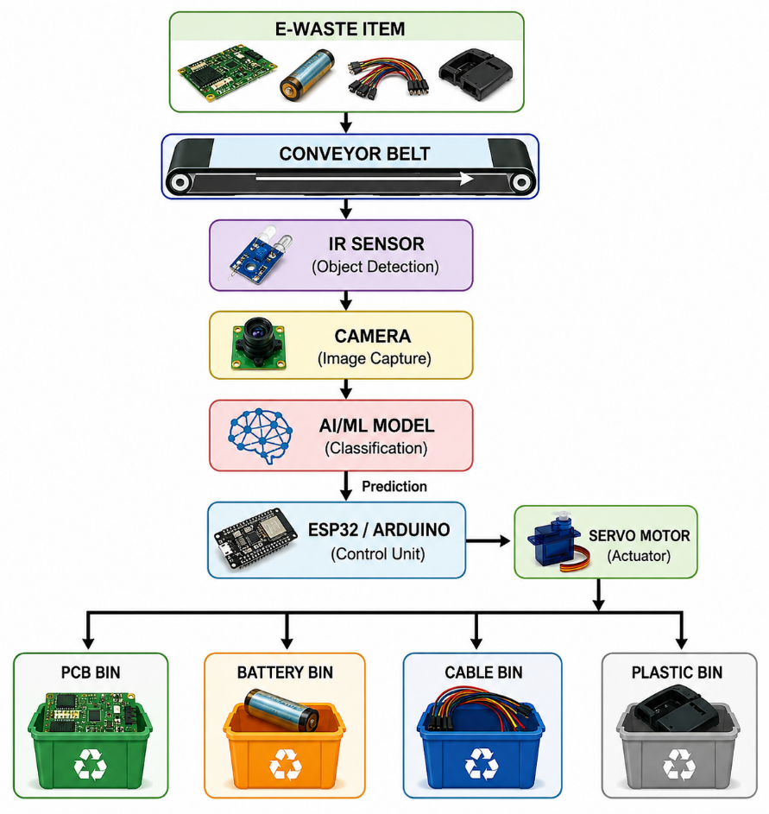
CONTENT
System Design
The block diagram shows the complete AI-based E-waste sorting process, from waste detection and image capture to AI classification. The classified item is then controlled by ESP32/Arduino and a servo motor and directed into the correct bin.
6

Slide 9
CONTENT
System Architecture
Layer 1 – Input Layer
Conveyor belt moves the E-waste.
IR sensor detects the incoming item.
Camera captures the image.
Layer 2 – AI Processing Layer
Image is given to the trained AI model.
Model identifies the E-waste category.
Classification confidence is calculated.
Layer 3 – Control Layer
ESP32/Arduino receives the classification result.
It calculates when the item reaches the sorting point.
Servo motor is activated accordingly.
Layer 4 – Output Layer
The servo flap directs the item into the correct bin.
Sorting information can be stored and displayed on a dashboard.
7

Slide 10
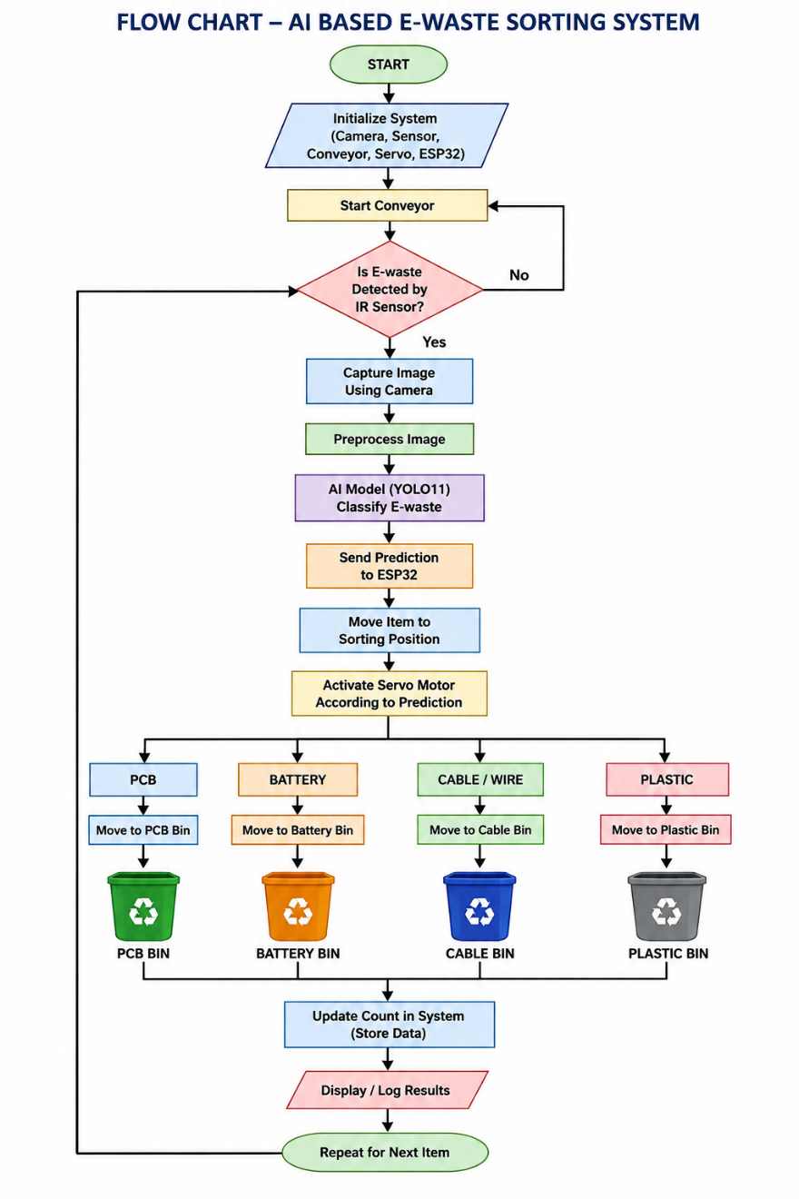
CONTENT
Flow Chart
10

Slide 11
CONTENT
Progress Achieved
Work Completed So Far
Literature Survey Completed Recent research papers on AI-based E-waste detection, classification, and sorting were studied to identify suitable methods and research gaps.
Problem and System Design Completed The problem statement, objectives, system architecture, block diagram, and workflow have been finalized.
Dataset Preparation Started Images of PCB, battery, cable/wire, and plastic electronic components are being collected and organized into separate categories.
AI Model Selection YOLO11 has been selected as the initial model because it supports fast image detection and classification.
Hardware Design Planned The required components such as conveyor belt, ESP32/Arduino, camera, IR sensor, DC motor, motor driver, and servo motor have been identified.
Prototype Development Started The basic conveyor and sorting mechanism is being designed to connect the AI prediction with automatic physical sorting.
8

Slide 12
CONTENT
Expected Results
E-Waste Identification – The AI model will identify PCB, battery, cable/wire, and plastic components.
Automatic Sorting – The system will automatically direct each identified item into the correct collection bin.
Working Prototype – A low-cost prototype integrating AI, camera, ESP32, conveyor, and servo motor will be developed.
Reduced Manual Effort – The system is expected to make E-waste sorting faster, easier, and more accurate.
11

Slide 13
CONTENT
Work Plan
Phase | Activity | Status
1 | Literature survey and problem identification | Completed
2 | Problem statement, objectives and system design | Completed
3 | E-waste dataset collection and preparation | In Progress
4 | AI/ML model training and testing | To be completed
5 | Conveyor and hardware development | To be completed
6 | AI + hardware integration | To be completed
7 | Testing, accuracy evaluation and improvements | To be completed
8 | Final prototype, documentation and presentation | To be completed
12

Slide 14
CONTENT
Expected Outcomes
Accurate Classification – Identify PCB, battery, cable, and plastic using AI.
Automatic Sorting – Sort each E-waste item into the correct bin.
Working Prototype – Develop a low-cost AI-based conveyor sorting system.
Reduced Manual Work – Make E-waste segregation faster and easier.
13

Slide 15
THANK YOU
14

